Slide 1
Wave Propagation Simulation
黃亮瑜 Andy (R07941005)
Date: 2018.12.05

Slide 2
Outline
Goal
Methods
Results
Most Challenging Parts
Time Spent
Summary

Slide 3
Goal

Slide 4
Simulate waves propagation in three glasses with different refractive indices by using FDTD.
Calculate the transmittance of each wave.
Compare the differences between results and theoretical values based on the Fresnel equations.

Slide 5
Methods

Slide 6
Define the problem
1800 nm
1200 nm
1200 nm
1200 nm
1800 nm
n=
1
1.2
1.3
1.1
1
Total size
7200 nm
Wavelength
600 nm

Slide 7
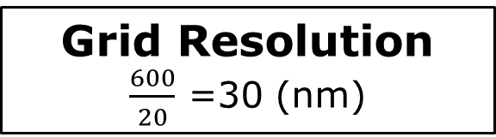
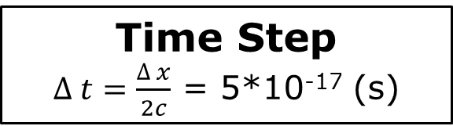
Define the problem
1800 nm
1200 nm
1200 nm
1200 nm
1800 nm
n=
1
1.2
1.3
1.1
1
Total size
7200 nm
Grid Resolution
$\frac{600}{20}$ =30 (nm)
240 grids
Wavelength
600 nm
Time Step
$∆ t=\frac{∆ x}{2c}$ = 5*10⁻¹⁷ (s)

Slide 8
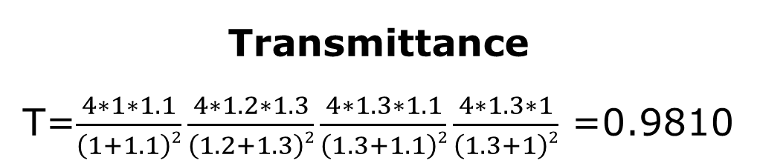
Calculate the theoretical value
1800 nm
1200 nm
1200 nm
1200 nm
1800 nm
n=
1
1.2
1.3
1.1
1
Fresnel equations
Transmittance
T=$\frac{4∗1∗1.1}{\left(1+1.1\right)2}\frac{4∗1.2∗1.3}{\left(1.2+1.3\right)2}\frac{4∗1.3∗1.1}{\left(1.3+1.1\right)2}\frac{4∗1.3∗1}{\left(1.3+1\right)2}$ =0.9810

Slide 9
Results

Slide 10
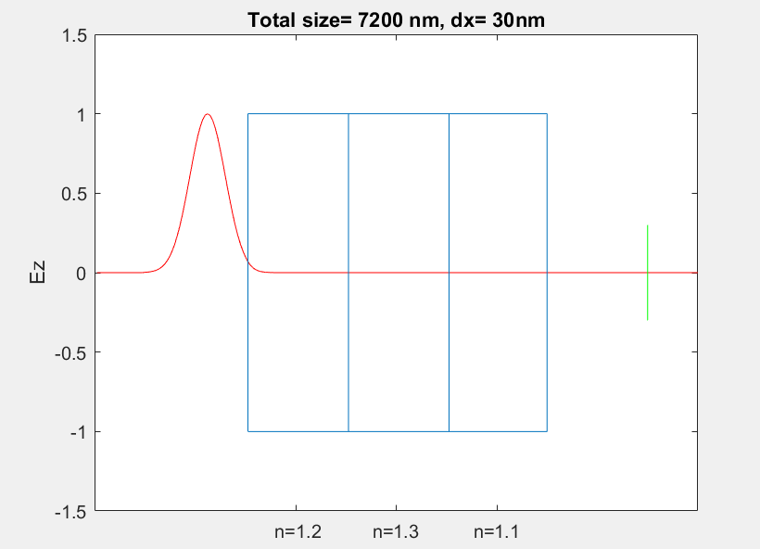
Resolution | Transmittance
30 nm | 0.9760
Fresnel equations | 0.9810
Resolution | Time-step
30 nm | 509
Theoretical time-step | 508

Slide 11
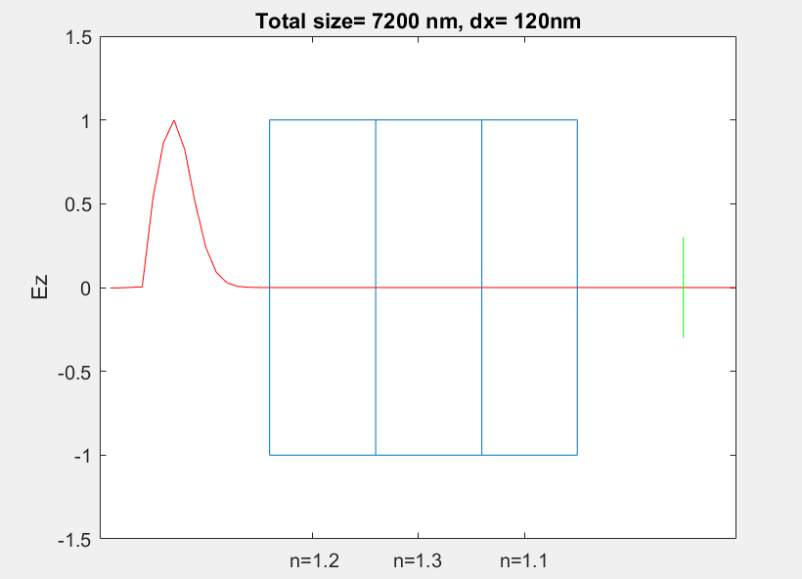
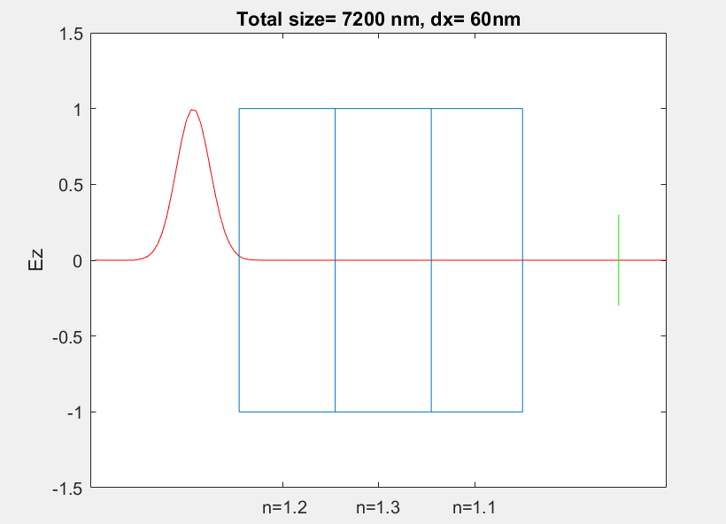
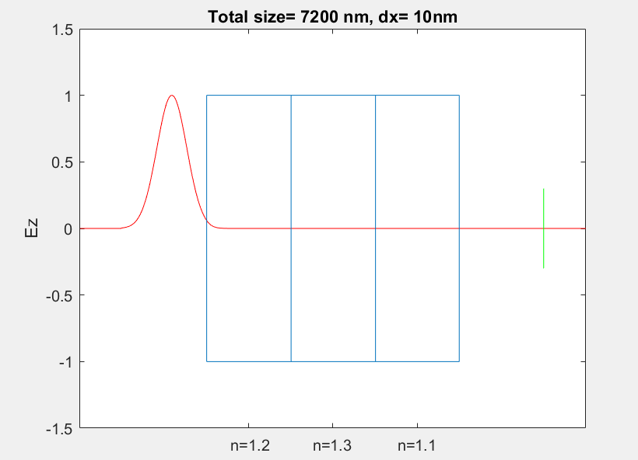
Resolution 120 nm
Resolution 60 nm
Resolution | Transmittance
120 nm | 0.6903
60 nm | 0.9227
30 nm | 0.9760
15 nm | 0.9805
10 nm | 0.9809
Fresnel equations | 0.9810
Resolution 15 nm
Resolution 10 nm

Slide 12
Resolution 120 nm
Resolution 60 nm
Resolution | Actual time-step | Theoretical time-step | Difference
120 nm | 130 | 127 | 3
60 nm | 256 | 254 | 2
30 nm | 509 | 508 | 1
15 nm | 1017 | 1016 | 1
10 nm | 1524 | 1524 | 0
Resolution 15 nm
Resolution 10 nm

Slide 13
Most Challenging Parts

Slide 14
Determine and calculate the resolution.

Slide 15
Time Spent

Slide 16
15 hours

Slide 17
Summary

Slide 18
The goal is to simulate waves propagation in three glasses with different refractive indices by using FDTD.
The higher resolution we set, the higher accuracy we get.

Slide 19
Thanks for your attention!

